Slide 1
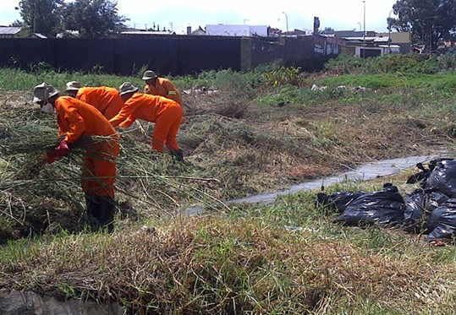
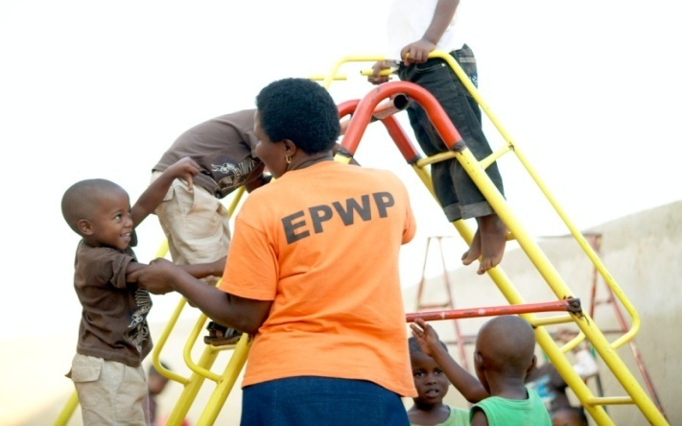
EPWP 6TH SUMMIT EPWP POLICY, RECRUITMENT GUIDELINES & AUDITS 14 NOVEMBER 2018

Slide 2
EPWP Policy Overview

Slide 3
Basis for the EPWP Policy Development
Since the inception of the EPWP in 2003, the programme operated without a written over-arching policy framework with its implementation guided by various policy documents such as the EPWP Ministerial Determination, approved Cabinet policy positions, etc.
The 2016 EPWP Summit and the 2017 Minister of Public Works Policy Statement resolved that an overarching EPWP policy be developed to address existing gaps identified in the programme.
To deliver on this assignment, an inter-departmental task team (consisting of sector lead departments and the ILO) has been established.
The work to develop an EPWP Policy has started in July 2018, broken down into two phases.

Slide 4
The EPWP Policy Development Process
Phase 1: Collation and consolidation of existing written policy prescripts of the EPWP in its current form.
This Phase was shorter in duration (2 months) and did not require extensive and wide consultations with stakeholders.
The work covered during this phase entailed:
Reviewing relevant material to feed into the EPWP Policy consolidation.
Engaging in necessary consultation with relevant stakeholders to secure their input.
Consulting the Steering Committee and relevant structures on the revision of the working draft policy.
Developing a consolidated inferred EPWP Policy.

Slide 5
The EPWP Policy Development Process…cont’d
Phase 2 - Review of the inferred policy (output of phase 1) and development of a future oriented EPWP policy, this is full scale policy development process, which requires wide and extensive consultation. This Phase will entail but not limited to:
Reviewing relevant material to feed into the Policy development process.
Participating in stakeholder consultation forums and accurately and systematic record inputs made.
Consolidate and synthesise inputs received from stakeholder forums.
Engage with the Steering Committee and relevant structures on revisions to the draft policy.
Develop an EPWP Policy.
It is envisaged that the assignment will be carried out over a period of 12 months from mid November 2018 – Nov 2019.

Slide 6
The EPWP Policy Development Process…cont’d
Gather information
Draft policy
positions
Consult with appropriate stakeholders
Finalise draft policy
Submit final draft policy to Cabinet for approval

Slide 7
Timelines –Policy Development (Phase 2)
No | Action | Proposed Date | Location | Present
1. | Task team meeting Roadmap development Defining scope of work | 12 Nov 2018 | Pretoria | EPRI Policy Task Team
2. | Inception report | 30 Nov 2018 | Online | EPRI
3. | Undertake research on EPWP draft policy | Dec 2018 – Jan 2019 | Pretoria | EPRI
4. | Interviews with stakeholders | Feb – March 2019 | All Provinces & via skype | EPRI
5. | Workshop with govt stakeholders on draft policy positions | April 2019 | Pretoria | EPRI & all EPWP govt stakeholders
6. | Revise draft policy positions incorporating comments from workshop | Mid April 2019 | Online | EPRI
7. | Consultations with MinTech and MinMecs | May 2019 | Pretoria | EPWP
8 | Draft policy positions submitted to Minister of Public Works to request approval for consultations | June 2019 | Pretoria | EPWP

Slide 8
Timelines –Policy Development (Phase 2)
No | Action | Proposed Date | Location | Present
9. | Public Consultations (Labour, Business, Community & Govt) | July - Sep 2019 | Provinces | Policy Task Team supported by EPRI
10. | Final draft policy incorporating inputs from consultations | Oct 2019 | Pretoria | EPRI & Policy Task Team
11. | Submission of the final draft policy to Clusters | Oct 2019 | Pretoria | EPWP Exco
12. | Submit to Minister of Public Works for submission to Cabinet | Oct 2019 | Pretoria | EPWP Exco
13. | Submission to Cabinet Committees & Cabinet | Nov 2019 | Pretoria | DPW

Slide 9
EPWP Recruitment Guidelines

Slide 10
Recruitment Guidelines in EPWP
The main potential risk area for corruption and fraud in the Expanded Public Works Programme (EPWP) is in the area of recruitment of participants.
To deal with the potential areas of corruption and risk in the recruitment of EPWP participants, the following measures have been put in place:
The EPWP Recruitment Guidelines have been developed in consultation with stakeholders and approved by Min of Labour in Dec 2018 to ensure alignment with existing labour prescripts in the EPWP, with Min of Public Works launching the guidelines on 28 June 2018.
The guidelines describe requirements for fair, equitable and transparent recruitment processes of participants into the EPWP.
Further, the guidelines aim to ensure uniformity across all sectors in the process of recruitment of participants and to provide guidance to EPWP stakeholders on their roles and responsibilities.
To raise awareness on the Recruitment Guidelines, at present the DPW EPWP Branch supported by Provincial Coordinating DPW are conducting roadshows across all provinces.

Slide 11
RECRUITMENT GUIDELILNES
CONTENTS

Slide 12
EPWP Recruitment Guidelines Principles
Transparency
Ethics
Fairness
The process should have a predictable methodology that affords equal opportunity to the target community (refer to Code of Good Practice on the EPWP).
The process shall not be manipulated for gain or to discriminate on the basis of colour, tribe, place of birth, ethnic or social origin, language, social status, religious belief, political affiliation, opinion, custom, culture, sex, gender, marital status, pregnancy, disability, economic or social status (refer to Constitution of RSA 1996).
Equity
Potential EPWP participants shall be given equal access regardless of their background in order to enable full and active participation in all aspects of the programme.
Target community members shall be afforded opportunity to witness and participate in the entire recruitment process.
Persons managing the recruitment process shall be answerable to relevant stakeholders for their actions.
Ethical behaviour shall include:
Avoidance of conflict of interests.
Devoid of personal gain.
Devoid of undue favours.

Slide 13
EPWP Recruitment Guidelines Principles
Respect for the environment
EPWP stakeholders should endeavor to sustain the environment for the benefit of future generations.
Commitment
Nurturing and protecting the wellbeing of the individual, family, communities and the nation through diligent execution of EPWP programme.

Slide 14
Key Issues for consideration- Recruitment of EPWP Participants
Roles and responsibilities - each public body is responsible for the recruitment and selection of EPWP beneficiaries on each project.
Responsive to EPWP Legislative Requirements – Code of Good Practice & Ministerial Determination
Community participation in planning processes - Before initiation of an EPWP project, the target community shall be mobilized to set up committee for presentation at various phases of the project.
Wage Determination - The public body shall set the wage level before the recruitment of participants, so that participants are not paid less than the minimum wage and not more than prevailing wages for similar work in the project area.
Adequate & Accessible Information - Community members shall have access to relevant, timely, accurate, and complete information to participate in the recruitment process
Induction – all new participants in the EPWP to be inducted on the EPWP, their duties, MD etc.
Eligibility – to be aligned with the self-targeting, community, and geographic targeting.
Targeting and selection - All EPWP implementing bodies must endeavour to meet the prevailing demographic targets

Slide 15
Roles & Responsibilities of EPWP Stakeholders
PROVINCIAL DPW
MUNICIPALITIES
To provide support to the roll out of the guidelines within the Provinces.
Must ensure that the recruitment of EPWP participants is aligned to the Recruitment Guidelines.
To conduct evaluation assessments on the impact of the Recruitment Guidelines.
To develop mechanisms to monitor compliance of the EPWP Recruitment Guidelines.
Utilise existing coordination structures to ensure progress in the implementation of the Guidelines.
To identify areas of concern with regards to the implementation and communicate them to the national DPW.
To ensure the social facilitation and induction workshops on the Recruitment Guidelines principles are undertaken.
To ensure that the recruitment process is undertaken in partnership with the community.
To ensure wage rates comply with the minimum EPWP wage rates – the rates must be communicated prior to recruitment.
To ensure alignment of existing EPWP policies with the Guidelines.
To conduct workshops on the implementation of the Guidelines.
To develop strategic documents (in this instance recruitment strategies) to assist in the implementation of the EPWP.
NATIONAL
To ensure that during the facilitation process, the communities are made aware of the recruitment process to be followed, the Ministerial Determination and Code of Good Practice.
To workshop the relevant community structures on the recruitment process of the EPWP Recruitment Guidelines.
A process of redress must be outlined before the commencement of the recruitment process.

Slide 16
Measures required to deal with non-compliance on the Recruitment Guidelines
Non-compliance will be dealt with at operational levels using existing institutional policies.
Implementing bodies must institutionalise a mechanism to expose non-compliance with this Recruitment Guidelines.
Implementing bodies must have mechanisms for redress and/or sanctions when duties and commitments are not met.
The Public Employment Programmes Inter-Ministerial Committee (PEP-IMC) may be leveraged if issues are not resolved at the operational level.

Slide 17
Communication focus
6 point communication plan
1
Media engagement
2
Marketing products
3
Social media and Website
4
Event (National launch)
5
Internal Communications
6
Stakeholder engagement session

Slide 18
ROLL OUT PLAN
Guidelines posted on 24 May 2018 to the EPWP Website @
www.epwp.gov.za
Social Media Campaign on Recruitment Guidelines
Marketing materials on the Guidelines including posters and brochures developed
Provincial Roadshows
August – Sept 2018
(Done in 5 provinces including KZN, LP, MP, WC, FS)
Presenting Guidelines at various workshops and forums and distribute marketing materials to all stakeholders
National launch of the EPWP Recruitment Guidelines
(28 June 2018)

Slide 19
EPWP 2017/18 Audit Outcomes

Slide 20
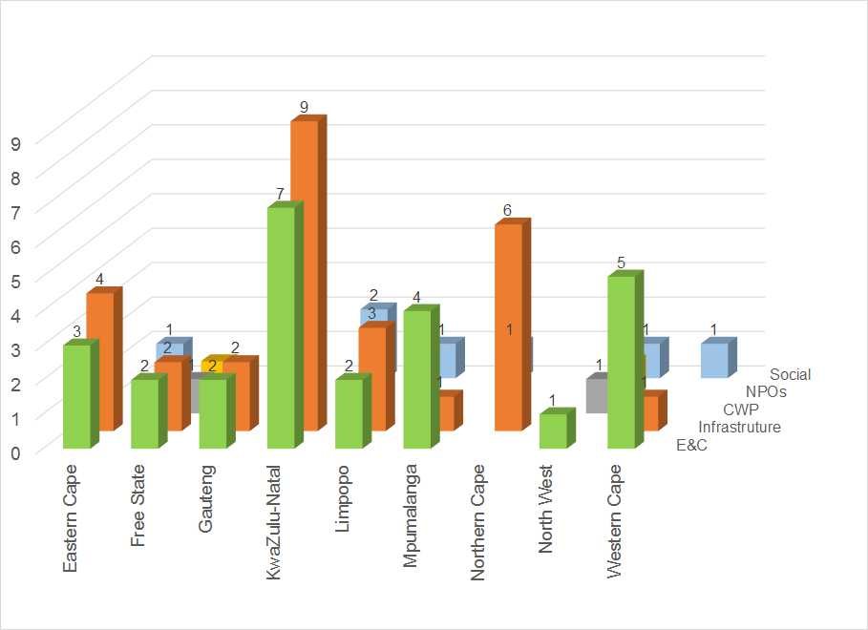
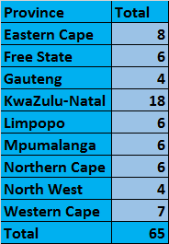
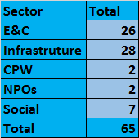
AGSA Sample: 2017-18 EPWP Final Audit
Notes:
AGSA performs two national audits on the EPWP each year. There is an interim audit after the conclusion of the second national quarter, which takes place in November/December and a final audit after the publication of the fourth quarter data, which takes place in May/June each year. Our discussion will start by focusing on the final AGSA in 2017.
AGSA originally sampled 66 projects. However, the Loeriesfontein Bulk Water Supply Project in Hantam Local Municipality was removed from the sample by AGSA due to the distance it needed to travel to cover the project. The final sample was therefore 65 projects. The sample covered all three spheres of government and all four sectors.
The graph shows the distribution of the sample per province and sector. The 18 projects in KwaZulu-Natal formed 27.7% of the total sample. 12.3% of the sampled projects were in the Eastern Cape and 10.8% in the Western Cape. Gauteng and the North West had only 6.2% of the sampled projects.
A total of 28 (43.1%) Infrastructure Sector projects, 26 (40.0%) Environment and Culture Sector projects and 7 (10.8%) Social Sector projects were sampled. For the Non-State Sector a total of 4 projects (6.2%) were sampled - 2 for the Community Work Programme and 2 Non-Profit Organisations.

Slide 21
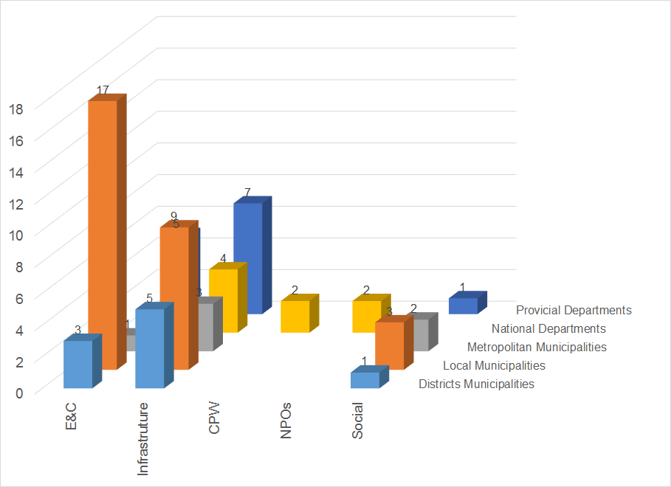
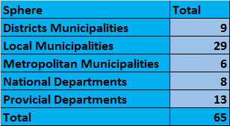
AGSA Sample: 2017-18 EPWP Final Audit
Notes:
8 (12.3%) of the sampled projects are from the national sphere; 13 (20.0%) from the provincial sphere and 44 (67.7%) from the municipal sphere, of which 6 (9.2%) are projects implemented by metropolitan municipalities.
A total of 9 882 work opportunities were reported in 2017/18 by the sampled projects. They reported a total of 3 123 FTEs.
13.8% of the sampled projects reported less than 50 work opportunities in 2017/18; 41.5% reported less than 100 work opportunities; and 13.8% reported more than 300 work opportunities.
3 Projects reported more than 400 work opportunities.

Slide 22
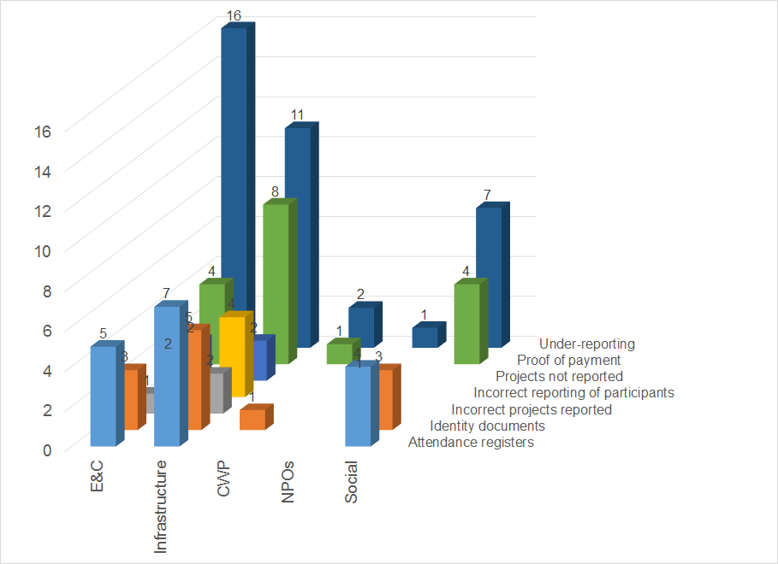
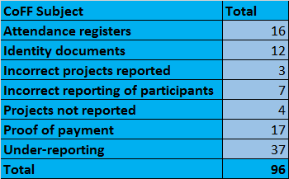
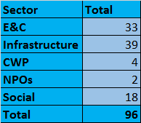
CoFFs for 2017-18 EPWP Final Audit: All Provinces
Notes:
For these 65 projects, a total of 96 Communications of Factual Findings (CoFFs) were raised by the AGSA.
Of these 96 findings, 37 related to under-reporting. These were cases where participants that were reflected in the attendance registers and proofs of payment were not reported on the EPWP RS. The AGSA requests at the start of the audit a list from the EPWP RS of the participants for each sampled project. One of the first checks that the AGSA performs is to check if this list corresponds to the records of the public body, i.e. to the attendance registers and proofs of payment of the sampled project. Neglect to report all the participants thus inevitably leads to a finding. This is also the case where the under-reporting is due to non-compliant participants, i,.e where the participants may have been reported but were not validated. Is thus crucial to ensure that all the participants are validated on the EPWP RS, so that they reflect in the final reports.
For 7 of the projects, there was incorrect reporting of participants. This is where participants were reported that did not actually work in the relevant financial year. Typically, what happened in these cases is that attendance registers were not referred to during reporting, i.e. there was coping and pasting from the past.
Both these findings reflect very negatively on the managerial oversight during reporting. It is exactly to strengthen this oversight that the authorization of data on the EPWP RS was instituted. If proper control is, however, not exercised during the authorization process, the process does not achieve its objective to ensure the integrity of the reported data.
3 of the findings related to the reporting of incorrect projects. It must be noted that all these findings were resolved. These were projects that were not completed as planned and were therefore carried over to the next financial year. Once AGSA established the veracity of this, the findings were resolved.
4 of the findings related to EPWP projects not reported. Typically the projects reflected on the list of MIG-funded projects, but were not reported due to operational issues such as conflict with contractors or insufficient capacity. In such cases is very important for EPWP coordinators to keep a paper trail of all the follow-ups that were do in this regard (e.g. at monthly meetings) and for the public bodies to put in writing the reasons for the non-reporting. The absence of such documentation at the time of the audit is interpreted as evidence that the projects were not reported due to neglect. Every effort must be made during the financial year to ensure that all EPWP projects is reported. Where capacity is lacking, it can be usually sourced from elsewhere if there is sufficient notice,
The findings that relate to attendance registers (16 findings), identify documents (12 findings) and proof of payment (17 findings) are cases where the public body could not submit these documents at the time of the audit. Such finding reflect very negatively on the ability to keep proper records, especially as the public body receive sufficient prior notice of the audit. (In the final audit, the sampled projects were communicated by 8 May 2018. The audit only started in Kwazulu-Natal in the week of 4 June 2018.) Where these findings remain unresolved, the assertion of poor record keeping remains. Without records, there is no basis for the reported data.
It should be noted that the AGSA resolved al the findings relating to identity documents not submitted, even where these documents were not submitted after the audit. This was due to the integrity of the IDs on the EPWP RS through the validation against the population register of the Department of Home Affairs. This was, however, a concession, and there is no guarantee that it would happen in the future.

Slide 23
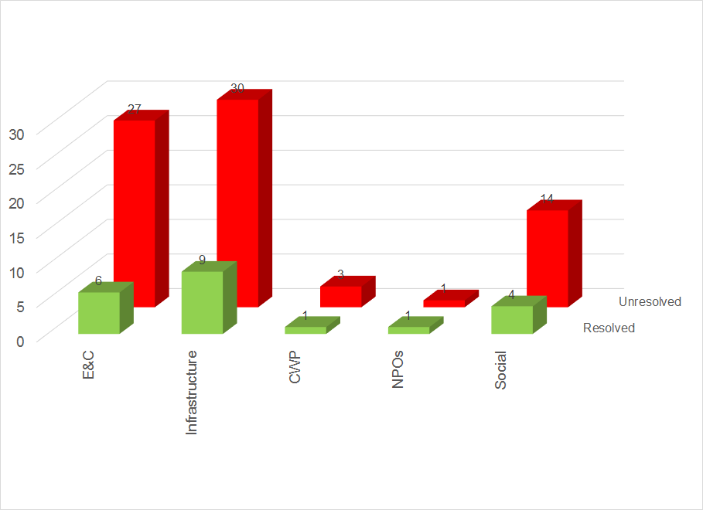
CoFFs for 2017-18 EPWP Final Audit: All Provinces
Notes:
A total of 21 of the 96 CoFFs were resolved.
Discounting the 12 CoFFs relating to identity documents and the 3 CoFFs relating to incorrect projects reported, only 6 of the other CoFFs were therefore resolved through the submission of additional POEs after the audit

Slide 24
Nature of AGSA findings for EPWP
AGSA Finding | Root Causes | Internal Controls
Participants not reported in the EPWP data produced from the EPWP-RS. Some Participants reported in the EPWP-RS have not worked on the project for the relevant financial year. | The EPWP guidelines in terms of reporting not followed by the public bodies. Beneficiary lists and attendance registers were not regularly reviewed to ensure that all participants are correctly captured on EPWP reporting system. For this to happen, the DPW relies on the public body. | The EPWP-RS has functionality that continuously report to public bodies those participants who do not pass validation. The public body was equipped to ensure that all valid participants are approved and reported on the system. The EPWP-RS is a reporting system. Validations on the compliance and internal consistency of captured data is possible, but under-reporting or the incorrect reporting of participants can only be detected through actual site visits by the Department. The Department does not have the funds and the required human resource to monitor all the reported projects continually through site visits. Whether site visits take place or not, proper record-keeping and oversight is an administrative responsibility of the public body.

Slide 25
Nature of AGSA findings for EPWP
AGSA Finding | Root Causes | Internal Controls
Project files do not have a clear copy of the certified identity document for all participants. | Proper record-keeping practices were not followed to ensure that participants are compliant and can be reported on the EPWP-RS. The Department relies on the public body for this. | The securing of certified ID copies is an administrative function for which the Department relies on the public body. Public bodies have been advised to ensure that the requirement for certified ID copies are written into contracts with service providers.

Slide 26
Nature of AGSA findings for EPWP
AGSA Finding | Root Causes | Internal Controls
Employment contracts were not in place or not signed by all parties. All the required signed and verified attendance registers were not in place. All the required proofs of payment were not in place. | Record-keeping and oversight was not implemented. The Department relies on the public body for this. Poor management of service providers by the public body underlies many of these cases. | Inadequate record-keeping or oversight by public bodies can only be detected through actual site visits by the Department. The Department does not have sufficient capacity (funds and HR) to monitor all the reported projects continually through site visits. Whether site visits take place or not, proper record-keeping and oversight is an administrative responsibility of the public body.

Slide 27
Nature of AGSA findings for EPWP
AGSA Finding | Root Causes | Internal Controls
All valid projects were not reported on the EPWP RS. | The EPWP guidelines in terms of requesting a change in the list of projects that are funded by grants are not always followed by the public body. Transfers are based on in-year monitoring reports to National Treasury, not financial data reported on the EPWP RS. It is verified if the public body has reported some of the projects on the list of projects that are funded by grant, not all. This is due to the quality of the financial data reported on the EPWP RS and the high rate of cancellation of projects by public bodies. For MIG-funded projects, public bodies may not implement or report projects due to internal issues ranging from lack of capacity to conflict with service providers. | There is an established process to be followed by a public body for requesting a change in the list of projects that are funded by grants. Public bodies are engaged in monthly meetings to ensure the reporting of all valid projects.

Slide 28
Action plan to resolve audit issues
Objective | Target
Realign monitoring through site visits to focus on compliance issues. | Transform current “site visits” into “public body visits”, focused solely on ensuring compliance and managed by EPWP M&E. The visits are to be done to the implementing public body and to have the format of an audit focusing on issues identified by both Internal Audit and AGSA. The public bodies to be visited to be sampled by EPWP M&E with strict adherence to the sample. Accounting Officers are to be immediately notified of findings picked up during this public body visits. Development of early-warning criteria by EPWP M&E to direct sampling for project visits.

Slide 29
Action plan to resolve audit issues
Objective | Target
Ensure the resolution of identified compliance issues. | Administration of an intervention register by EPWP M&E to ensure the resolution of all compliance issues identified in the project visits through the allocation of responsibility (to Sector Managers or Programme Managers) and timelines. Non-resolution of compliance issues within a reasonable timeframe to translate into action taken for the public body.

Slide 30
Action plan to resolve audit issues
Objective | Target
Ensure integrity of lists of grant-funded projects. | Resubmission of lists of grant-funded projects by the public bodies for which not all such projects have reported by the end of the third quarter, to ensure that these lists have not been changed unilaterally by the public body. Ensure POE of engagement with public bodies to ensure the reporting of all valid projects.

Slide 31
Thank you very much for your attention
Ms Lindiwe Nkuna
Acting Chief Director: EPWP Sustainable Livelihoods, Convergence and Compliance
Email: Lindiwe.Nkuna@dpw.gov.za
Tel: 012 492 3011
Cell: 082 413 9975

